Slide 1

LOAN PREDICTION
BASED ON CUSTOMER
BEHAVIOR
BY AWESOME CITI NEUEDA GROUP

Slide 2




DEVESH
PATEL
AMNA
WAJAHAT
CHRISTOPHER
PARKER
ADAM
KOCSIS
Jupyter Notebook & Tableau
Tableau Dashboard
Tableau Dashboard
Jupyter Notebook

Slide 3

DISCUSSION OUTLINE
TODAY'S HIGHLIGHTS
Data Description
Data Exploration
Conclusion

Slide 4

WHAT IS LOAN
DEFAULTING?
Notes:
A borrower defaults on a loan when they stop making payments on their loan. For most loans this means the borrower hasn't made several consecutive payments, breaking the terms of the agreement. The point when a loan is considered to be in default depends on the type and terms of the loan. In our case the type of loan that the data is based on has not been specified.

Slide 5
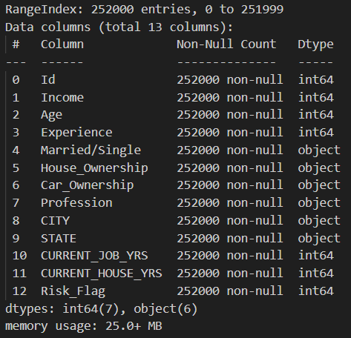
DATA INSTANCES FROM INDIA
28 THOUSAND SAMPLES
13 ATTRIBUTES PER SAMPLE
NO MISSING ATTRIBUTES
INTEGER, BINARY, AND CATEGORICAL DATA
HYPOTHESIS?
Notes:
the data was provided by univ.ai an independent AI and data science learning program. The data consists of 28 thousand samples with each samples having 13 attributes including a binary default attribute that represents if a sample defaulted or not, some other attributes include age, income, profession, geographic data, and data about owned property and marital status.

Slide 6

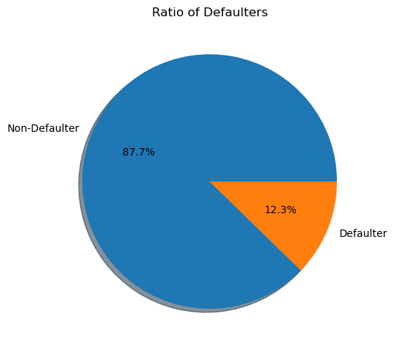
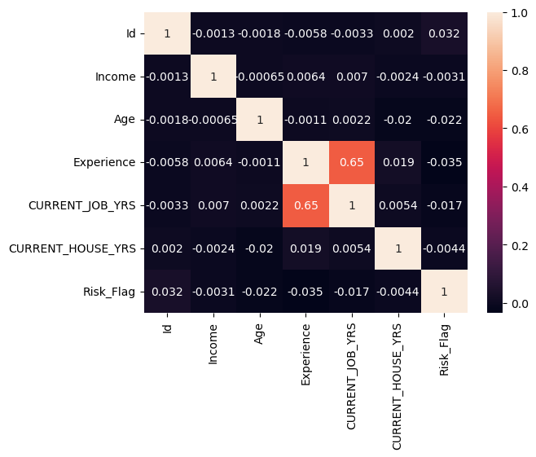
FINANCIAL INSPIRATION:

Slide 7
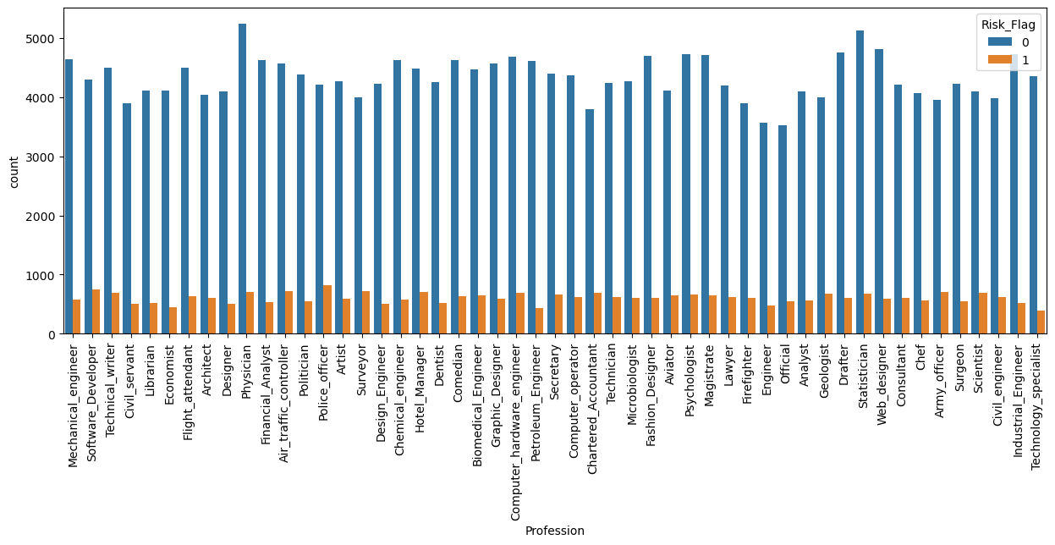
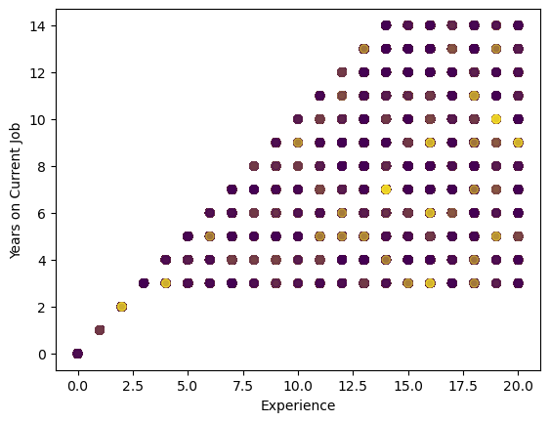
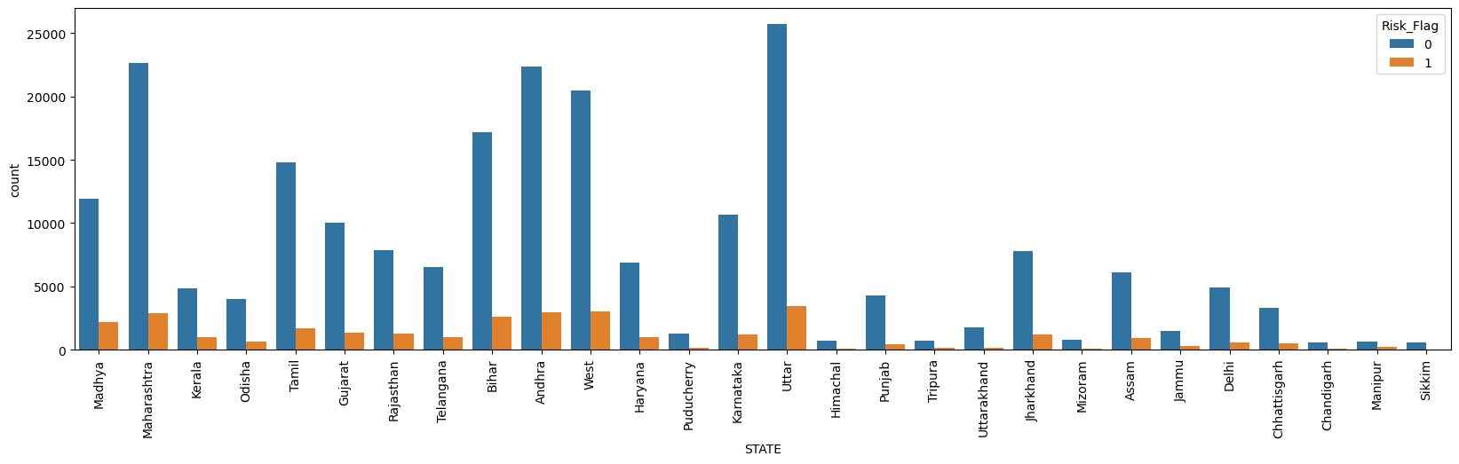

Slide 8
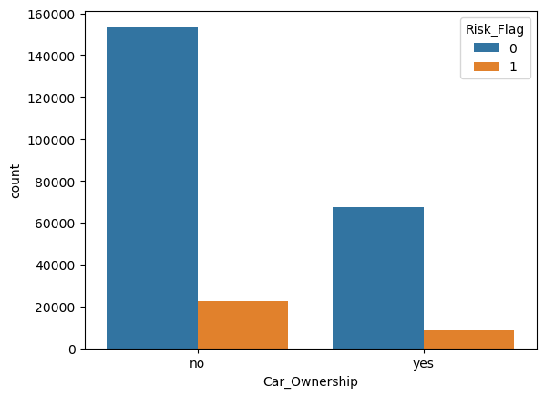
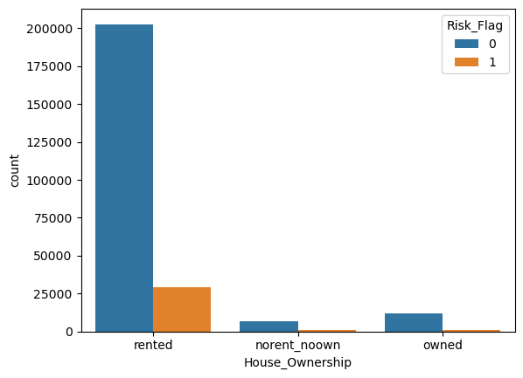
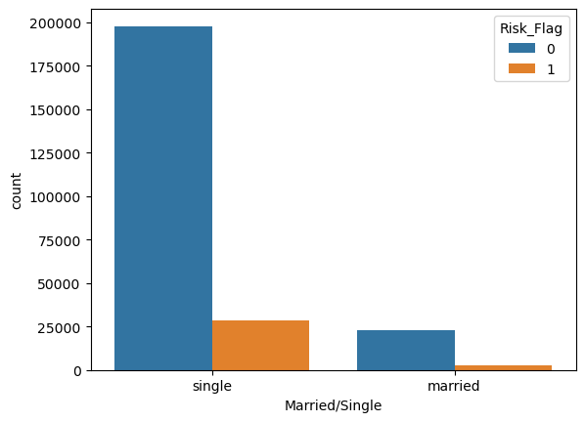
PROPERTY ANALYSIS
HOUSE OWNERSHIP
CAR OWNERSHIP
MARITAL STATUS

Slide 9
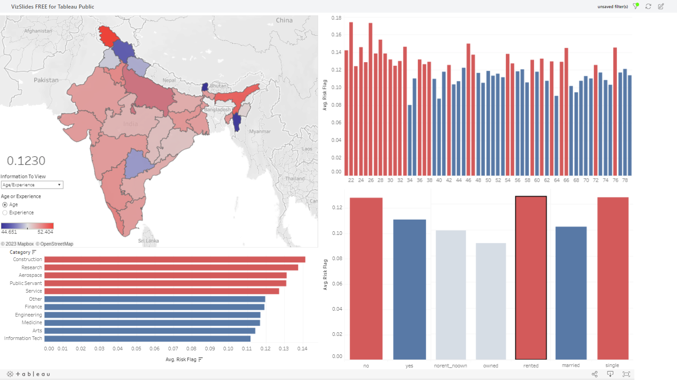
DASHBOARD GOES HERE

Slide 10

Strong Indicators?
Conclusion
Weak Indicators?
Notes:
Repeat the hypothesis. Strong indicators are house ownership, marriage, young age and low experience. Weak indictors are occupation, location, Income and car ownership. Explain this a bit too

Slide 11
DECISION TREE SLIDE

